Slide 1
A Sketch-Based Approach To Video Retrieval Using Qualitative Features
Koustav Ghosal and Anoop Namboodiri
Center for Visual Information Technology
IIIT Hyderabad, India

Slide 2
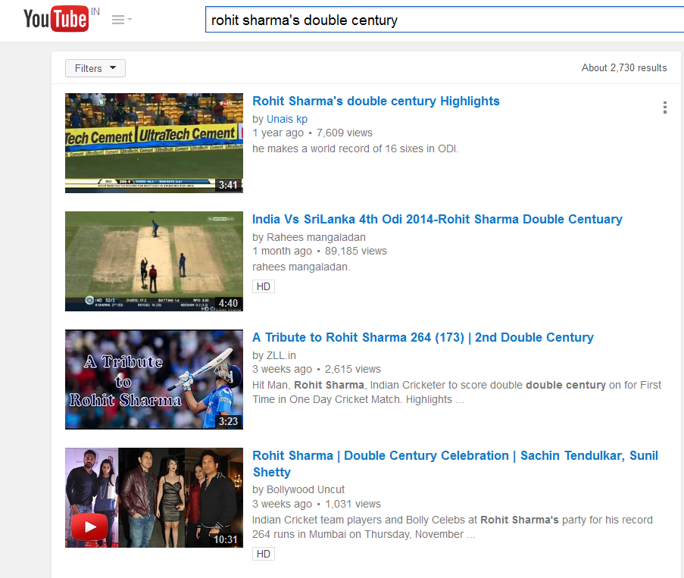
Content Based Video Retrieval
Different Form Of Queries :
Text Example Sketch
Text Based Query :
Video Search from Youtube
“ Coke Studio Pakistan ”
“ Markov random Field Daphne Koller ”
“ Rohit Sharma’s Double Century ”
Metadata : Tags, Comments etc.

Slide 3
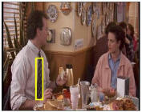

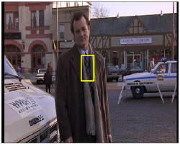

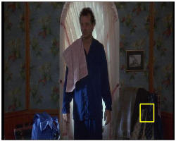

Content Based Video Retrieval
Different Form Of Queries :
Text Example Sketch
Example Based Query :
Video Google¹
Input :
Image or Objects of interest
Output :
Relevant Shots or Key Frames
Sivic et al, ICCV 2003

Slide 4
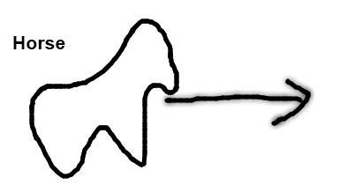
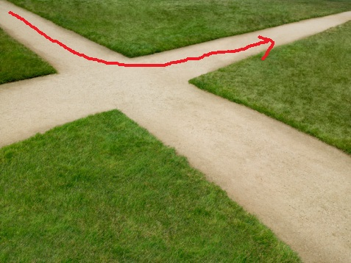
Content Based Video Retrieval
Different Form Of Queries :
Text Example Sketch
Video Q ¹ Surveillance ²
Chen and Chang : Fifth ACM international conference on Multimedia. ACM, 1997.
Hu et al : PAMI 2006

Slide 5
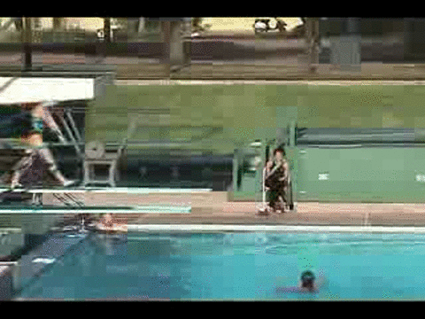
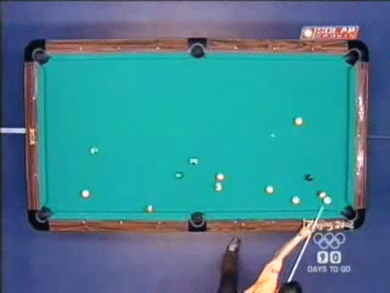
Sketch vs Text/Example based
“ A diving video where the diver does a somersault before going down … ”
“A pool shot where the player strikes from below and the white ball moves north-east, then north west then south-west and finally strikes another ball. The second ball drops inside the pocket … ”
Example is not always available.

Slide 6


Sketch vs Text/Example based

Slide 7




Challenges
Background Extraction
Camera Motion
Occlusion
Illumination
Background Noise
and many more…
Perceptual Variability
Users perceive the same motion differently

Slide 8
Qualitative vs Quantitative Feature Space
Approximations instead of absolute numeric values to remove perceptual variability
Qualitative Spatio-Temporal Features Features that capture “how” (qualitative) objects moved rather than “how much” (quantitative)

Slide 9
Problem Statement
The Problem Statement : Modelling the query (user sketch) and original trajectories using “qualitative” features instead of “quantitative” features to remove perceptual variability.
Assumption : Trajectories are available for a set of videos.

Slide 10
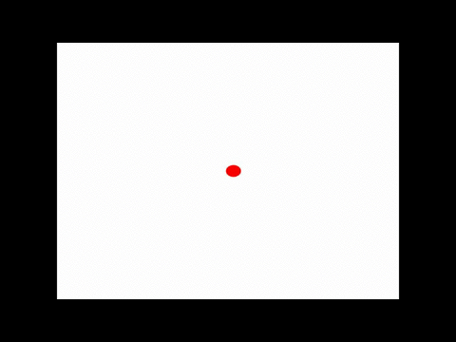

Aspects of Motion
Shape: Linear and non-linear sub-trajectories.
Direction: Similar in shape but have different directions
Scale: Different scales of same motion
S-A-I-O
S-C-I-O
S-C-O-I

Slide 11
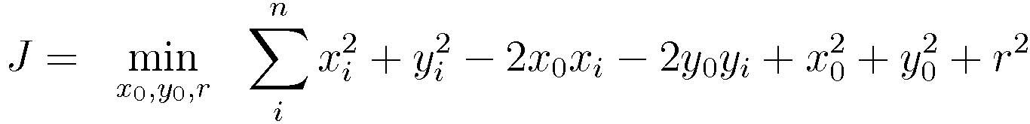
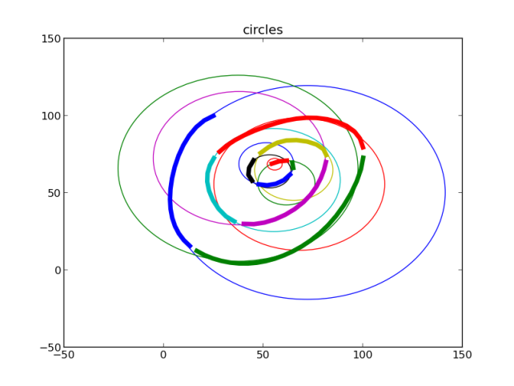
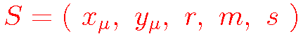
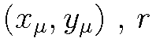
Shape : Circle Based Features
= Center , Radius
m = Slope
s = Normalized Length
K- Means , Bag-Of-Motion
Trajectory = Histogram of motion-segments = Loss of temporal Information !!
1. Sivaprasad et al, ICDAR 2013

Slide 12
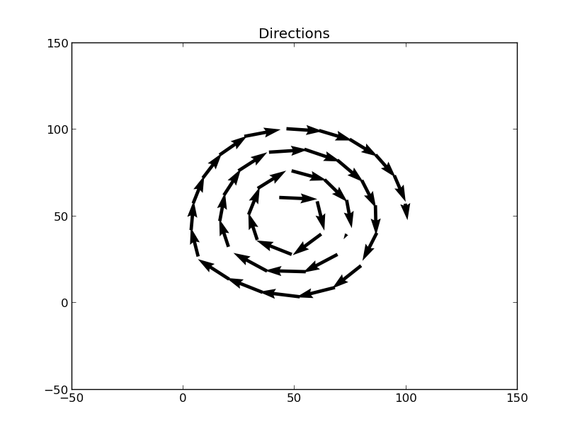
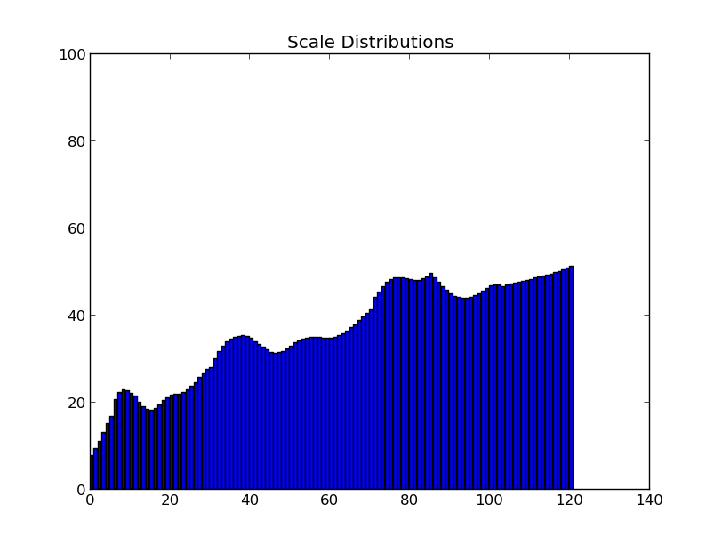
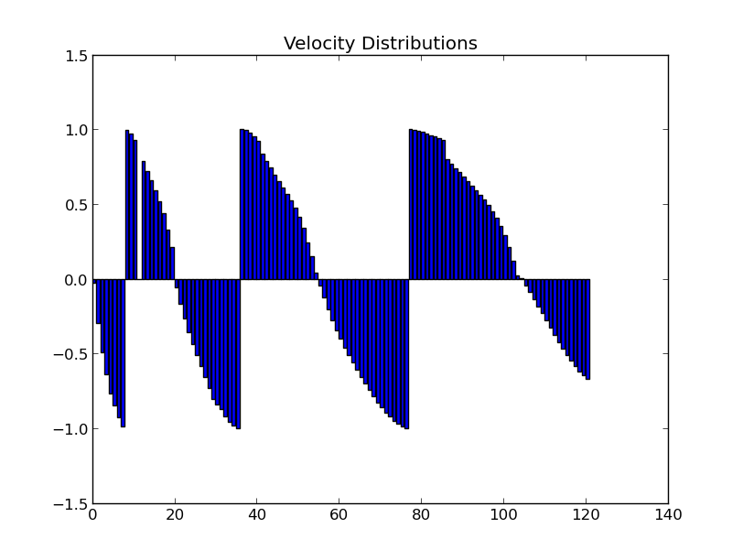
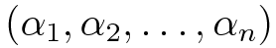
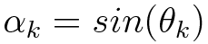
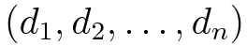
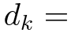
Direction And Scale
Scale
Trajectory
=
… (1)
Trajectory
=
Distance from mean … (2)
Direction

Slide 13
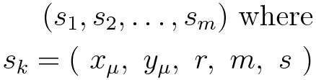
Summary of Features
Bag-Of-Motion
Ordered Motion
Segments
3. Change of Direction
4. Change of Scale
Both For User-Sketches and Videos

Slide 14
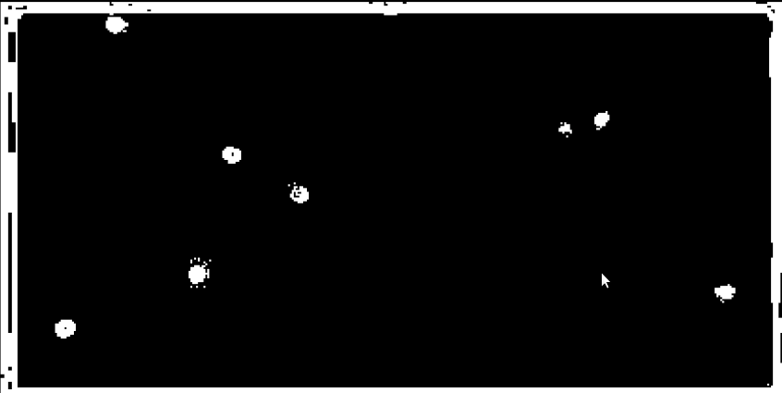
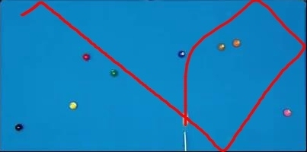
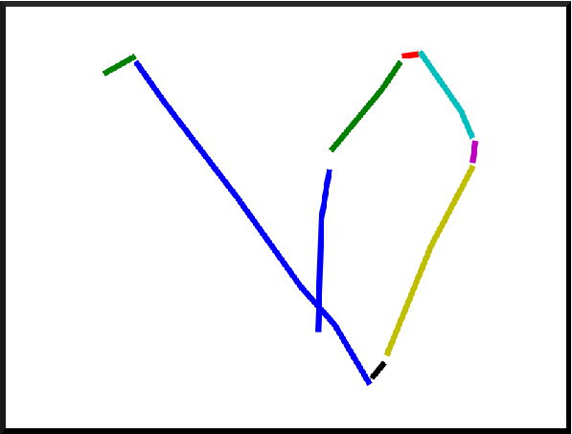
Dataset
100 Synthetic videos and 100 pool videos
Foreground
Kalman Filter Tracking
M- Segments
Data was collected from 50 different users
Interval of 6 hours between video and sketch

Slide 15
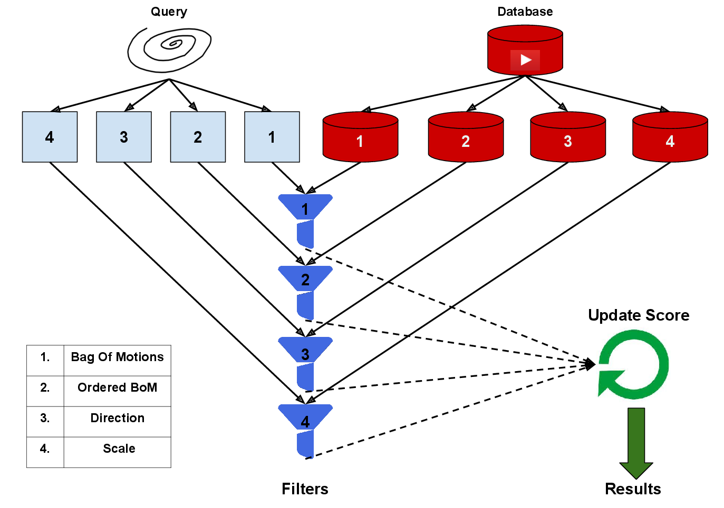
Cascade

Slide 16
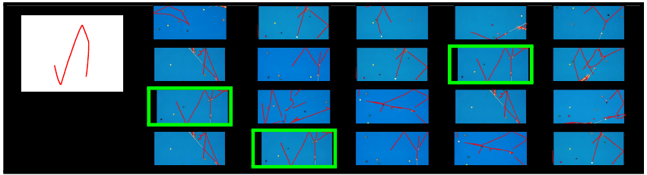
Results : An example query
BOM
Sequence of
BOM
Sequence of
Directions
Sequence of
Scales

Slide 17
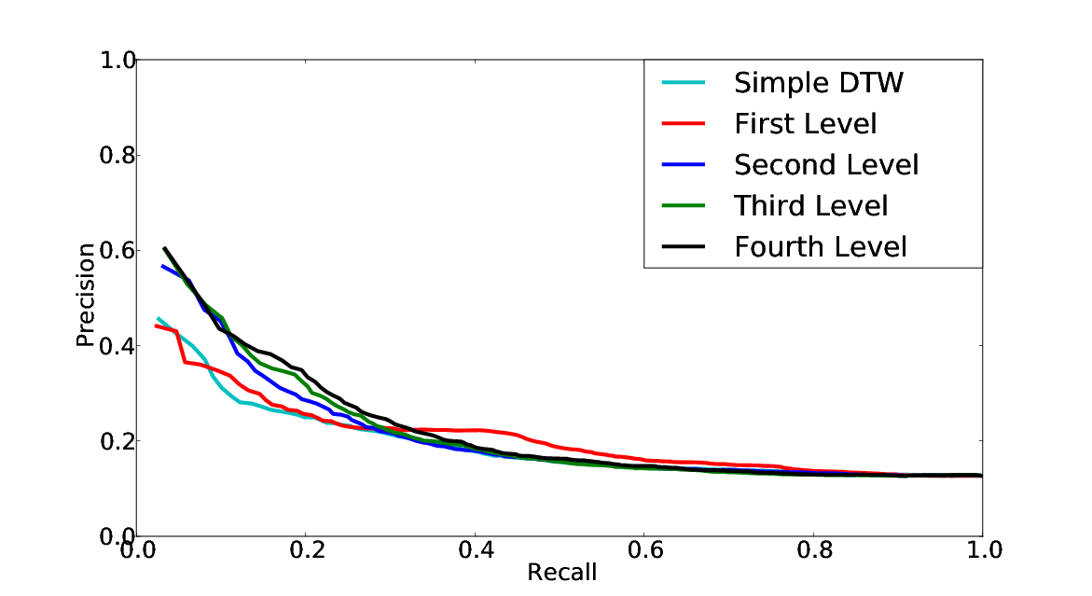
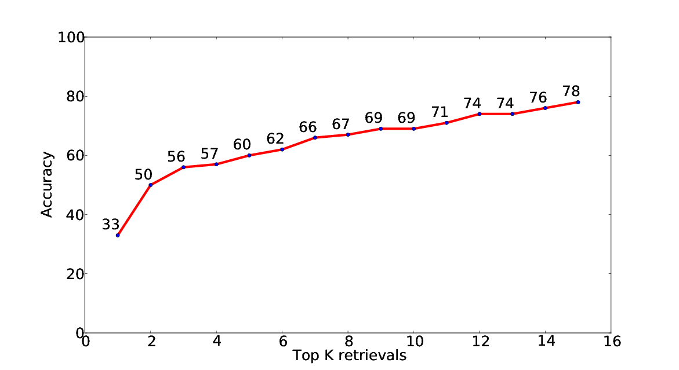
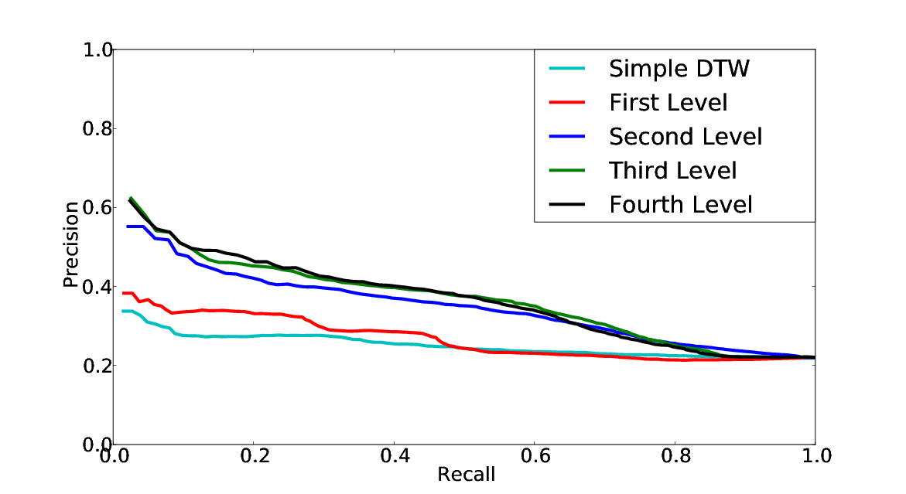
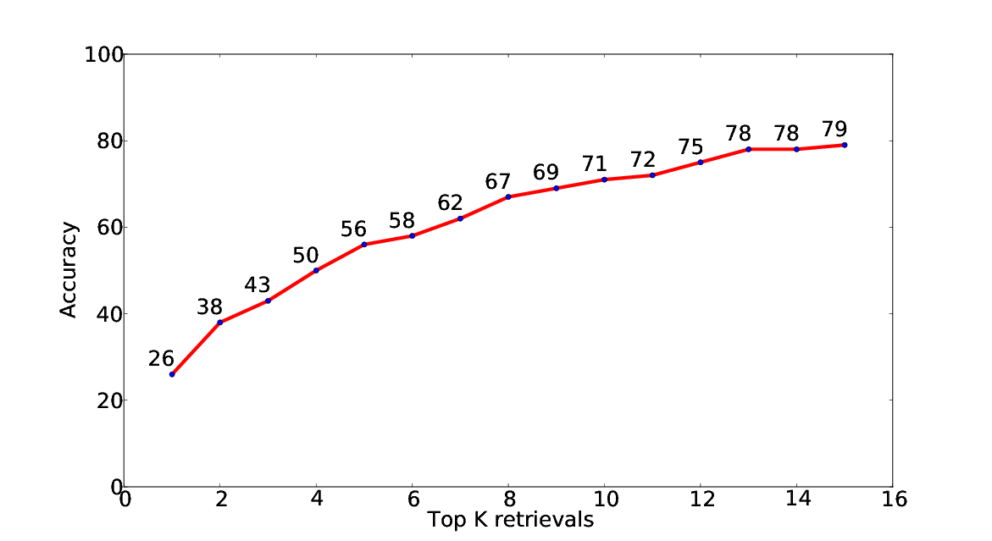
Results
Pool
Synthetic
Precision - Recall
Top K Accuracy

Slide 18
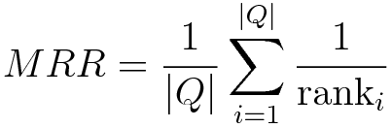
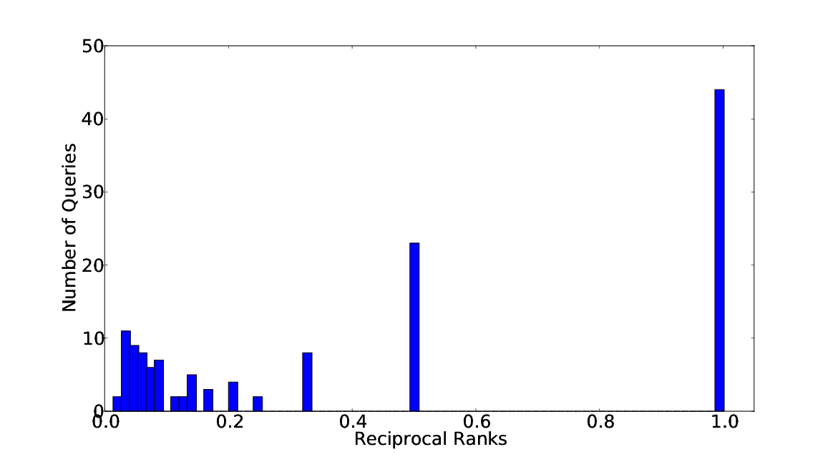
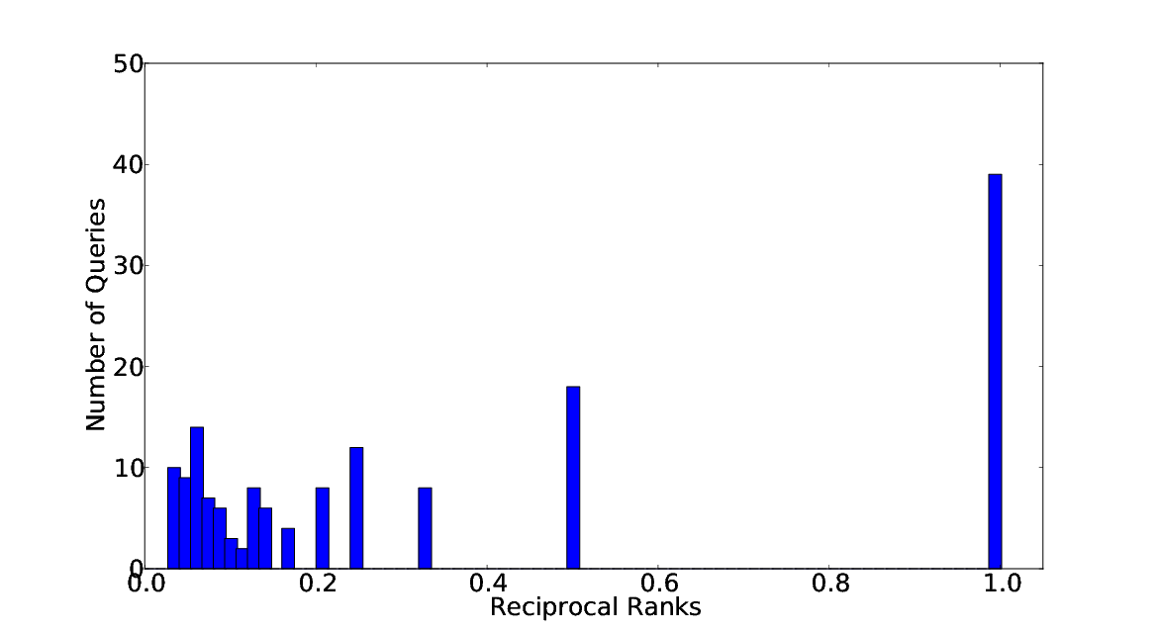
Results
Mean Reciprocal rank
Pool
Synthetic

Slide 19
Summary
Strengths
Unconstrained Query : No initial frame
Qualitative Features : Robust to user-level variations
A novel retrieval strategy : Cumulative Scoring Mechanism
Limitations
Dependency : A strong trajectory extraction algorithm
Not generic : Doesn’t work for videos where motion is not the most salient feature

Slide 20
Future Work
Finding new features to expand the scope of this representation to more generic videos
Using additional information about object color and shape to refine the search
Generating consistent tracks from videos with camera motion and large perspective variations

Slide 21
Thank you

